Slide 1
Visualizations- Project 2
By
Avani Patel, Alysha Wood, Andrew Tobin, Theresa Myers

Slide 2
Is alcohol consumption correlated to a nation’s happiness?

Slide 3
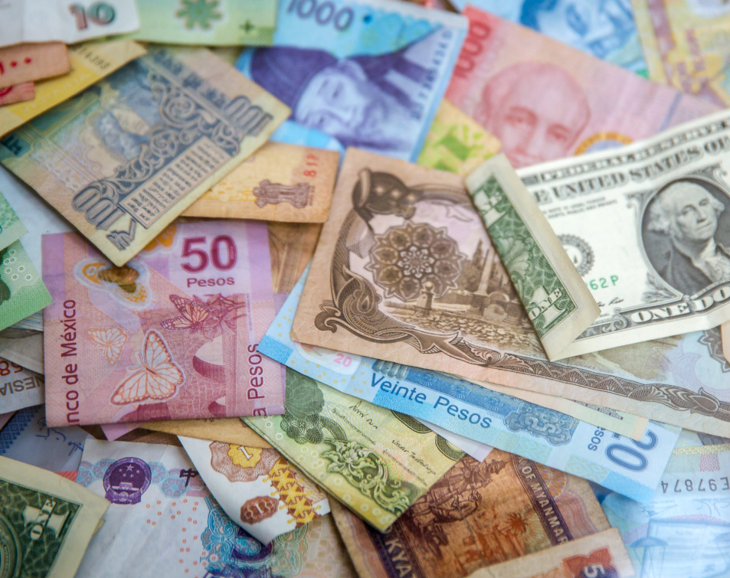
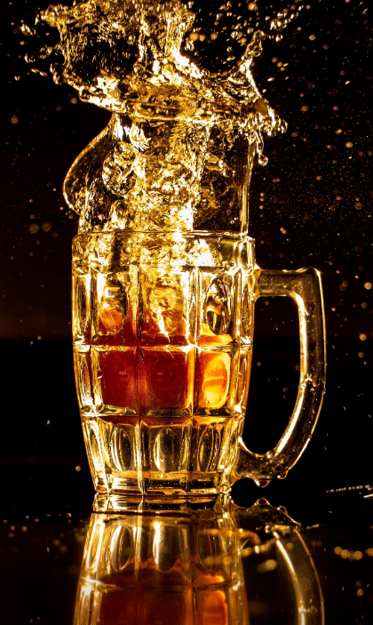



Slide 4
Procedure
Download data from Kaggle: two datasets with happiness, Drink Servings per Capita, and GDP per Capita
Combine and clean-up the two datasets in Postgres
Main Index Page
3a. Bar Chart: Beer, spirits, and wine consumption per person per country
3b. Scatter Plots: Happiness v. Alcohol, Happiness v. GDP
3c. Mapbox: Data Summary per Region

Slide 5
Javascript
Libraries
d3
plotly
chart.js

Slide 6
Example Code for each Section

Slide 7
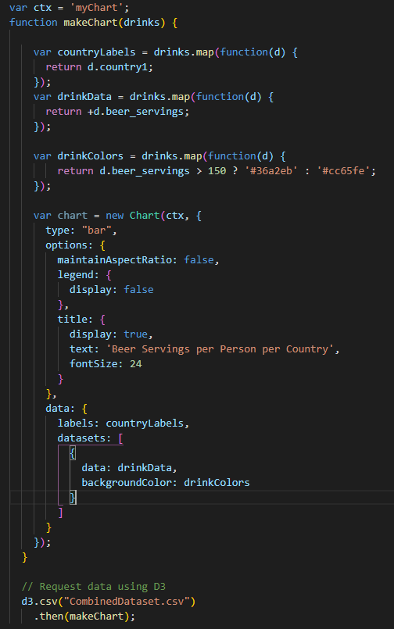
Section 3a: Bar Charts
Using chart.js, we created a bar chart for the beer, spirit, and wine consumption per person per country.
After calling the chart.js library, we created a function to make the chart, and then used d3 to read into the csv file and use the function to create the related chart.

Slide 8
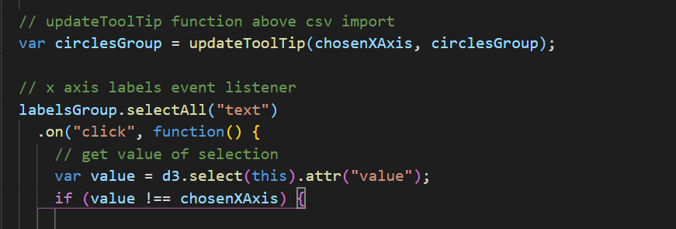
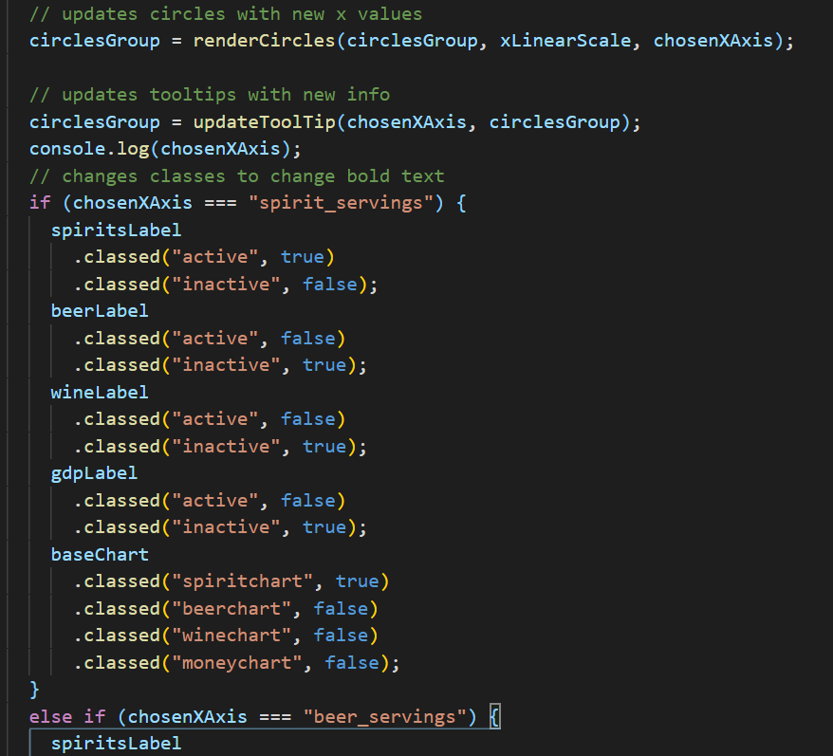
Section 3b: Scatter Plots

Slide 9
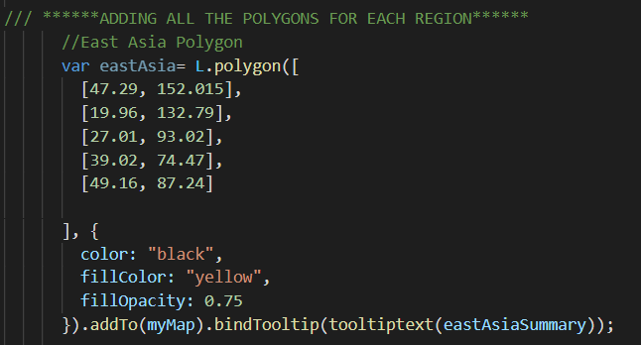
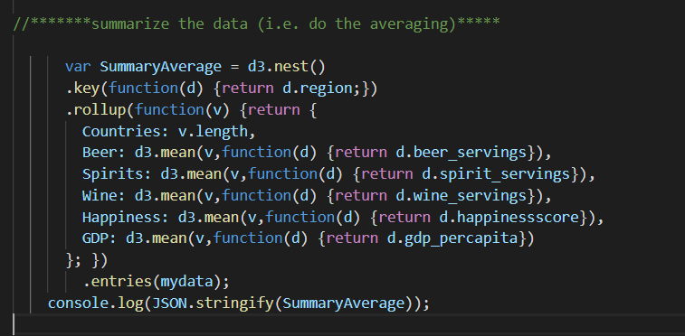
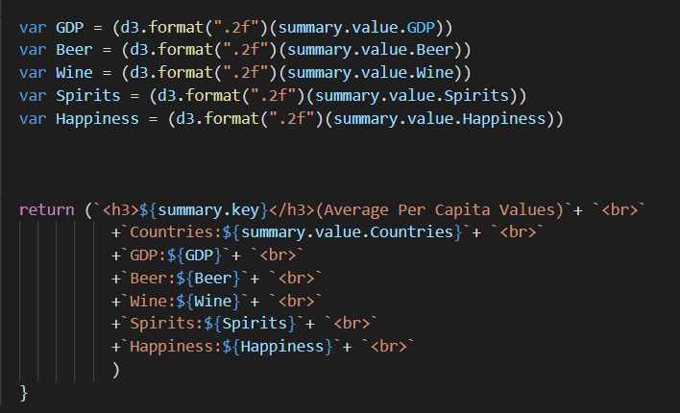
Section 3c: MapBox
Added polygons of the Regions
Summarized the data by Region
Added the Summary as Pop-up for each Region Polygons

Slide 10
Conclusion
It appears that the No. of Alcohol Servings per Capita do not have a good correlation with Happiness Score of the Country.
As suspected, GDP is a better indicator of Happiness Score of the Country.
There are other factors which we did not study such as Healthcare, Education, Stability, which may also be better indicator of Happiness.

